Slide 1
VEP results
Adam Shah

Slide 2
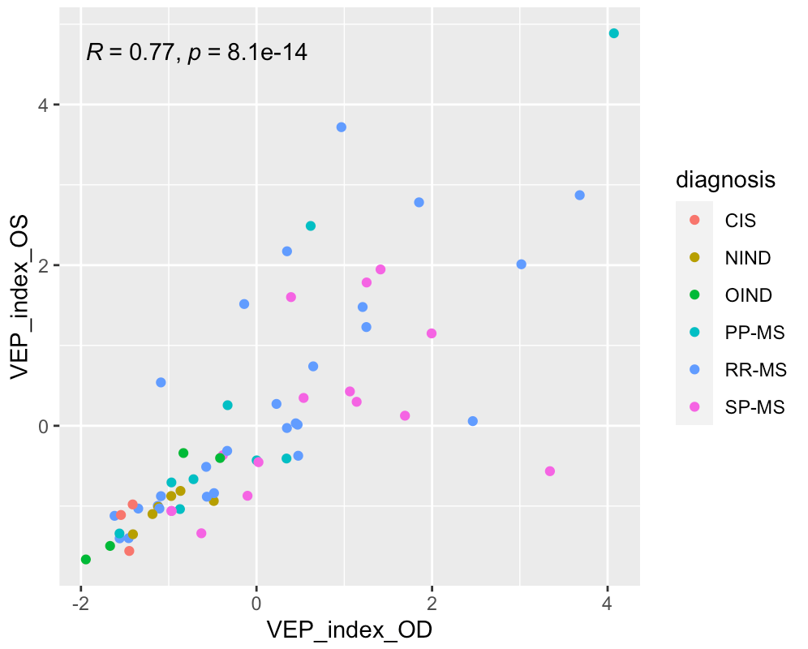
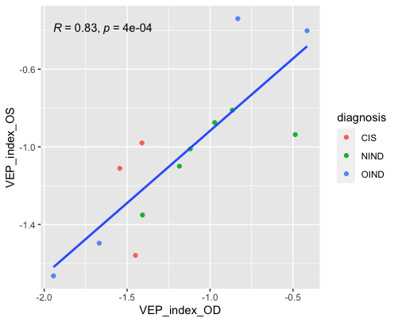
Correlation in VEP index between eyes in whole dataset vs. non-MS patients

Slide 3
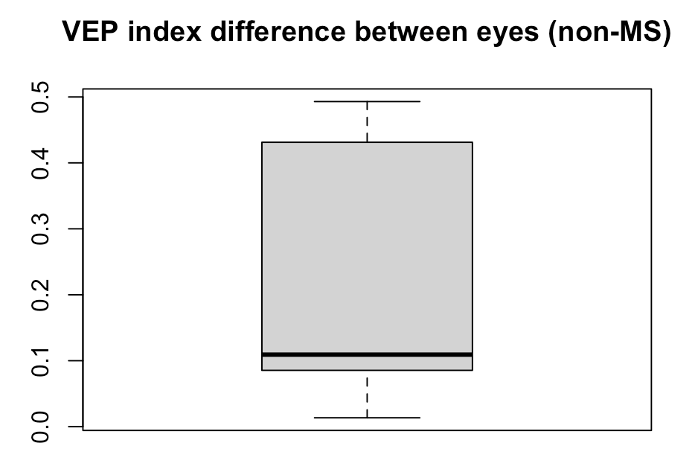
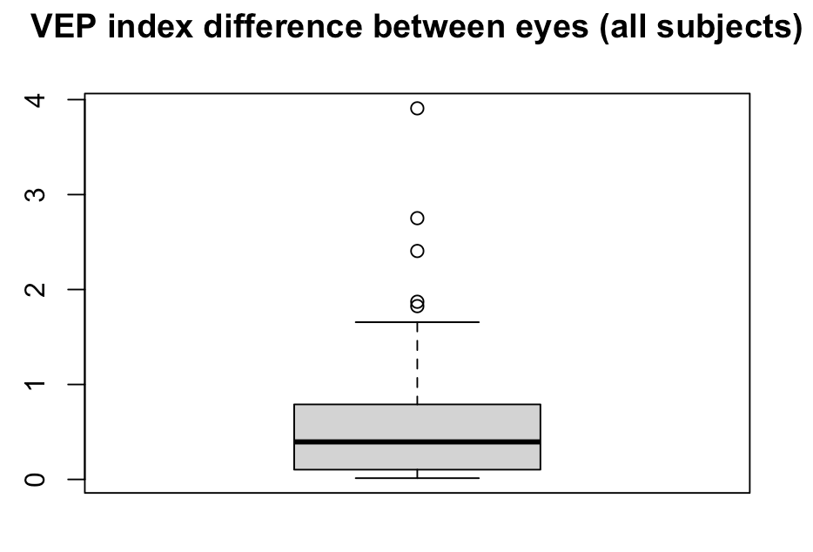
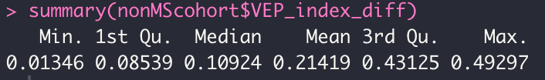
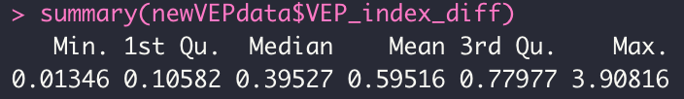
“Normal” VEP index difference between eyes
IQR for non-MS cohort suggests “normal” VEP index difference is less than about 0.43

Slide 4
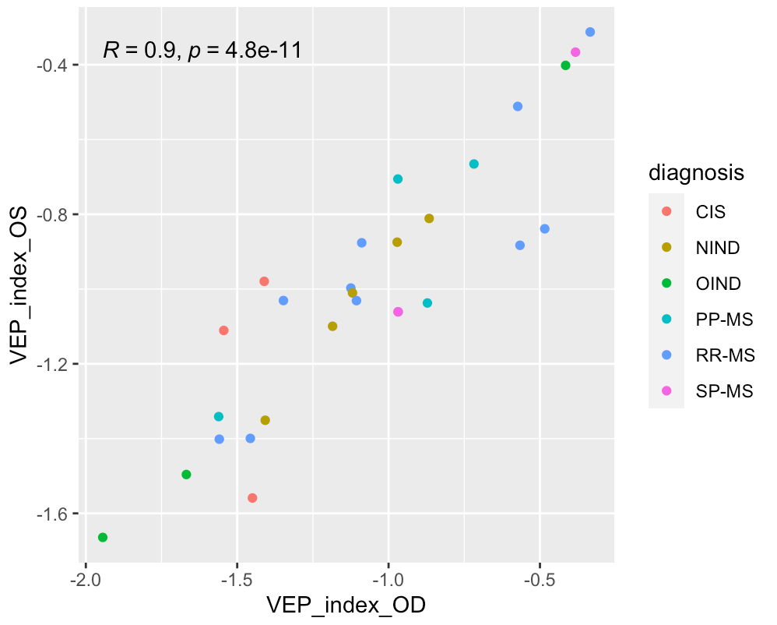
Isolating “normal” eye individuals
For now, ”normal” significance assigned by
VEP index < 0 and VEP index difference below the
3Q mark for non-MS individuals (0.431)
*includes normal eyes from non-MS and MS patients

Slide 5
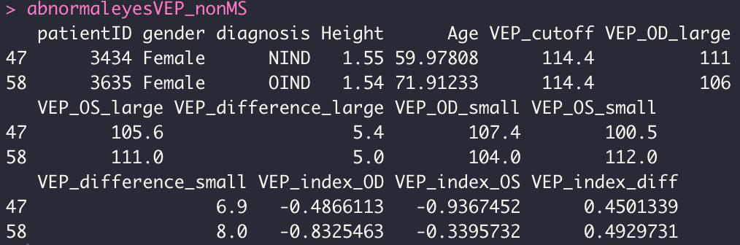
“Abnormal” eyes in non-MS cohort
Both patients disqualified based on VEP index difference, so the eye with the larger VEP index is deemed “abnormal”
(larger VEP index correlates with longer VEP time):
OD abnormal for patient ID 3434
OS abnormal for patient ID 3635

